Slide 1

Health Risk & management
Training
IOGP/IPIECA IH Subcommittee
May 22

Slide 2

Health Risk Assessment & Management: A roadmap for the Oil & Gas industry, IOGP Report 384, 2021 (Rev 2)
Executive Summary
A commitment to health risk management is a fundamental principle held by oil & gas business management. The Health Risk Assessment (HRA) & Management process ensures the identification of health hazards, assessment & control of potential risks to health, avoiding occupational illness in employees & contractors.
Revision 2, is a significant update since Revision 1, published over 10 years ago
Change: Increased emphasis on health risk management within business, new risk assessment techniques, up to date references & examples, a compendium of case studies, good practices & a simple excel based HRA tool
Notes:
Revision 1 Published 2006, Leaflet & Part 2 document (68+ pages)
Shortened industry focused guide with compendium

Slide 3
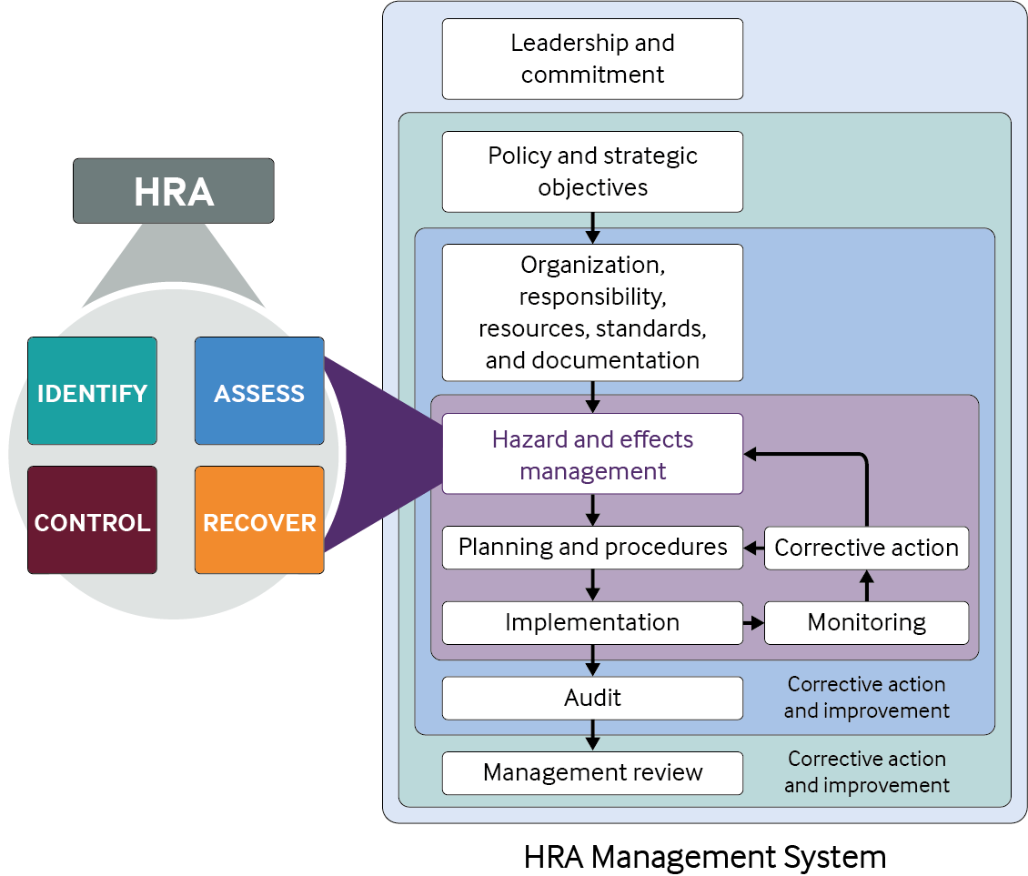
Health risk assessment and management within the business model (1)
(1) Alignment with business objectives
HSE programmes enable businesses to effectively & efficiently meet operational effectiveness goals & include
Licence to operate
Business continuity
Emergency preparedness and response
Human performance
Regulatory compliance and responsible standards
(2) HSE Management system & integration of health
(3) Management communication and engagement
Management support is essential
Annual health risk management plans
Notes:
Alignment with business Objectives
Licence to operate – stakeholder expectations for successful operations incl. maintaining a safe and healthy workplace
Business Continuity plans e.g. pandemic planning
Emergency preparedness & response e.g. team drills & vapour release consequences
Human performance – ensure effective workforce incl health surveillance FTW, well being initiative
Regulatory compliance and responsible standards – workplace HSE regulations, industry guides
(2) HSE Management system Health risks managed systematically as part of HSE Management System; Business management owns HSE-MS & accountable for implementation . Describe process flow
(3) Management communication & engagement is essential: HRA annual management plans should be in alignment with the business financial planning & budget cycle & should involve front-end input from health risk assessors, HSE counterparts

Slide 4
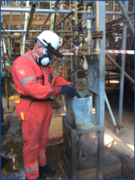
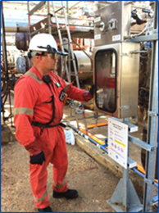
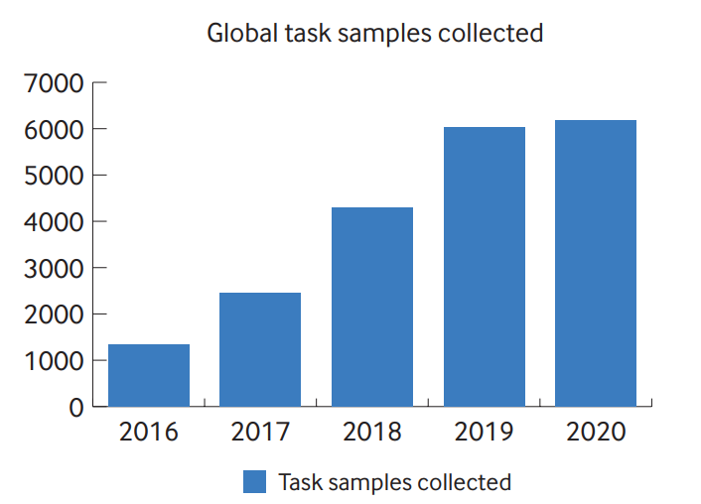
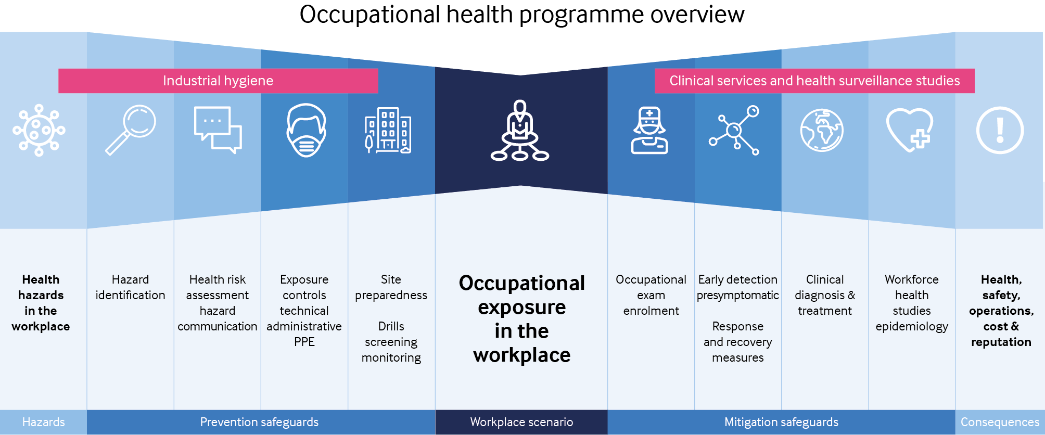
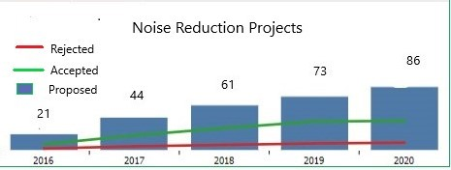
Health risk assessment and management within the business model (2)
(4) Metrics and performance indicators
Data quality metrics
Health risk assessment process/activity metrics
Programme effectiveness/outcome metrics
(5) Communication Tools
Keep communications brief,
straightforward & visual
where possible
Communication & business
partnering of risk & control
Communicate successes
Before and after visual example using photographs for a benzene exposure control improvement using closed loop system
Notes:
Metrics and performance indicators for health risk management are a key element to evaluate programme effectiveness and value to the business
Data quality metrics – ensures data is sufficient quality for decision making e.g. % HRAs not approved by occ hygienist
Health risk assessment process/activity metrics – measure points in process e.g. % HRAs complete per plan; chart with blue bars is driving an increase in sampling for short term tasks
Programme effectiveness/outcome metrics – Engineering solution implementation, action close out, Chart with blue bars - green line shows the number of engineering technical measures accepted and implemented and the red line shows the projects not accepted and that remain reliant on the weaker safeguard of PPE. This type of metric can help drive implementation of engineering/technical solutions versus administrative or PPE controls
Management communication and engagement should be short e.g. bow ties (blue diagram)
Ensure management understand risk and why risk reduction is important

Slide 5
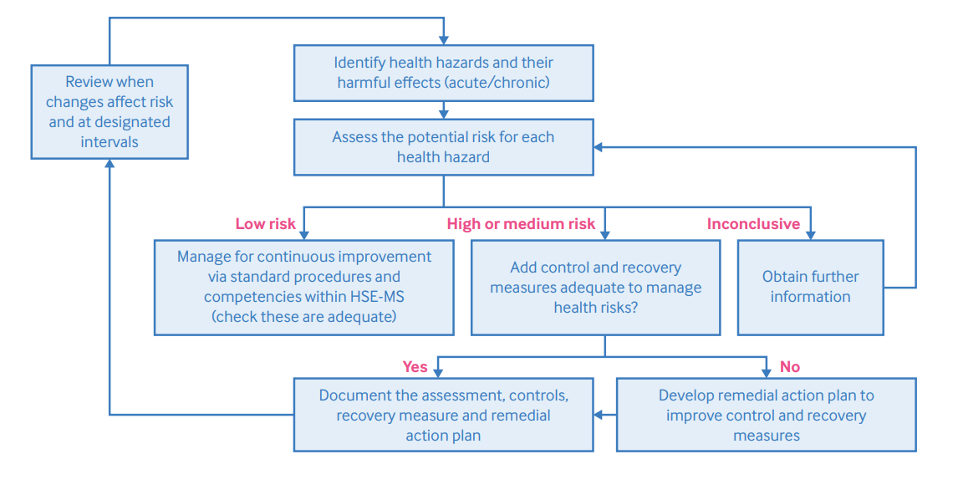
Health risk assessment (1)
AIM: To identify workplace health hazards, evaluate their risks to health & determine appropriate control & recovery measures.
Notes:
It is a systematic approach used to evaluate the potential for harm and protect against any adverse exposure. This figure shows the elements of HRA and the process

Slide 6
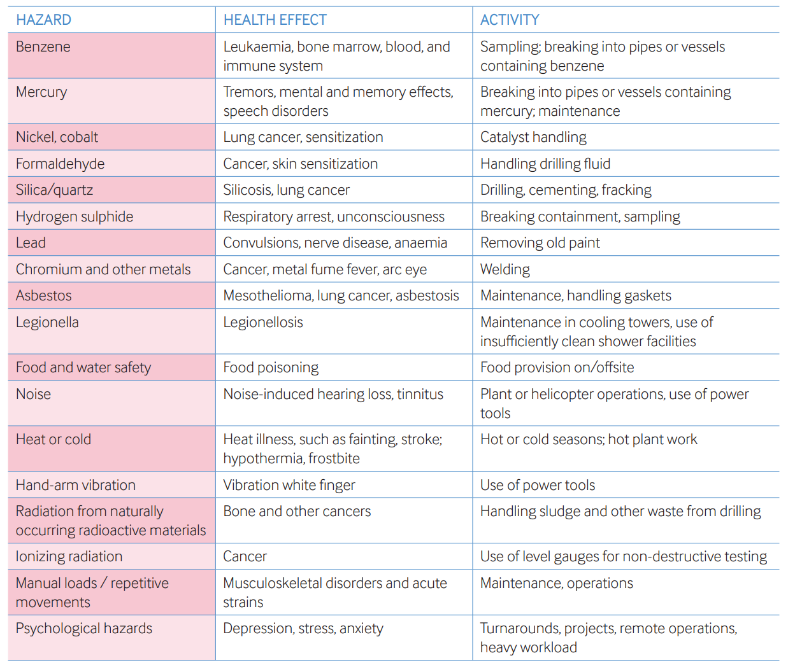
Health risk assessment (2)
Organization, scope & resources
Hazard identification including inventory & hazard assessment
Health risk assessment process
  Risk rating schemes
  Qualitative risk assessment methodology & tools
  Quantitative exposure assessment: types, future technologies
  Simple spreadsheet tool provided (slide 8)
Example higher-risk hazards, health effects, and activities in the oil & gas industry
Notes:
Scope – e.g. New activities and developments, Existing operations, Changes to existing activities etc
Resources & organisation – depends on depth complexity & scope of HRA e.g. single assessor vs team with specific knowledge & expertise
Hazard inventory chemical, biological physical, ergonomic & psychological factors
Risk Assessment:
Consideration of factors e.g. quantity, frequency, process details, controls in place etc. Observation (if possible) is important. Use of video technology can aid if not.
Quantitative assessment involves collecting data to further quantify exposure using personal, direct reading methods & modelling methods. Advances being made in sensor technology & big data

Slide 7
Health risk assessment (3)
Health Risk Management
  Control & recovery Measures
  Maintenance of control & recovery measures
  Communicating controls & recovery measures
  Health Surveillance & occupational epidemiology
  Documenting & reviewing HRAs
  Competence & training of Assessors
Notes:
Control: incl. hierarchy of control i.e. elimination, substitution, technical organisation & PPE (RHS of bow tie)
Recovery: incl. medical emergency response, clinical treatment, health surveillance (LHS of bow tie)
Maintenance ensures control/recovery measures reman effective e.g. LEV testing, maintaining procedures, cleaning & repairing PPE
Communicating includes action management, information & training (permit to work, toolbox talks etc)
Health surveillance/occ. Epidemiology – e.g. to identify early signs, symptoms/ examine health outcomes of groups of workers exposed to hazards
Document/review HRAs: records kept, review if change
Competence: Assessors (training, W201). Occupational Hygienists (IOHA NAR scheme)

Slide 8
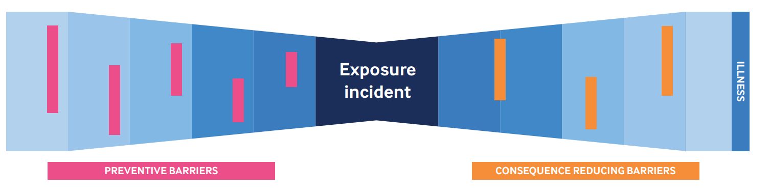
Health risk management (3)
Health Surveillance & occupational epidemiology
Documenting & reviewing HRAs
Competence & training of Assessors
Control & recovery Measures
Maintenance of control & recovery measures
Communicating controls & recovery measures
Notes:
Control: incl. hierarchy of control i.e. elimination, substitution, technical organisation & PPE (RHS of bow tie)
Recovery: incl. medical emergency response, clinical treatment, health surveillance (LHS of bow tie)
Maintenance ensures control/recovery measures reman effective e.g. LEV testing, maintaining procedures, cleaning & repairing PPE
Communicating includes action management, information & training (permit to work, toolbox talks etc)
Health surveillance/occ. Epidemiology – e.g. to identify early signs, symptoms/ examine health outcomes of groups of workers exposed to hazards
Document/review HRAs: records kept, review if change
Competence: Assessors (training, W201). Occupational Hygienists (IOHA NAR scheme)

Slide 9
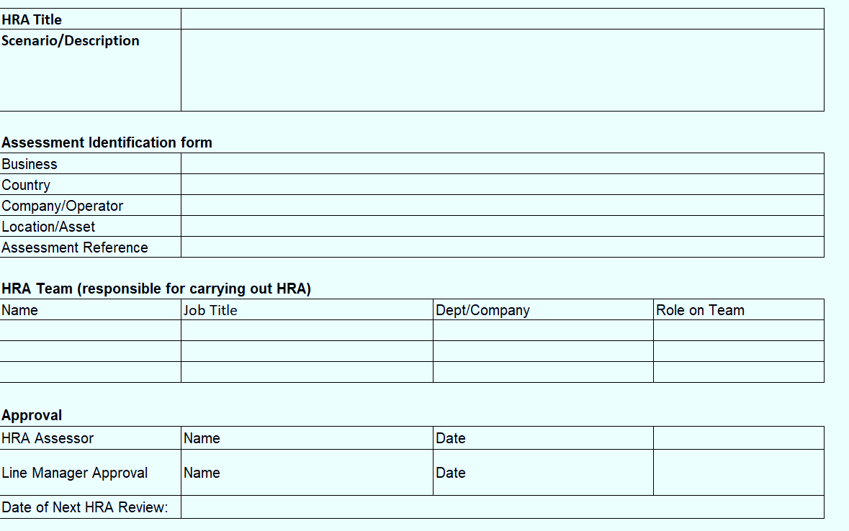
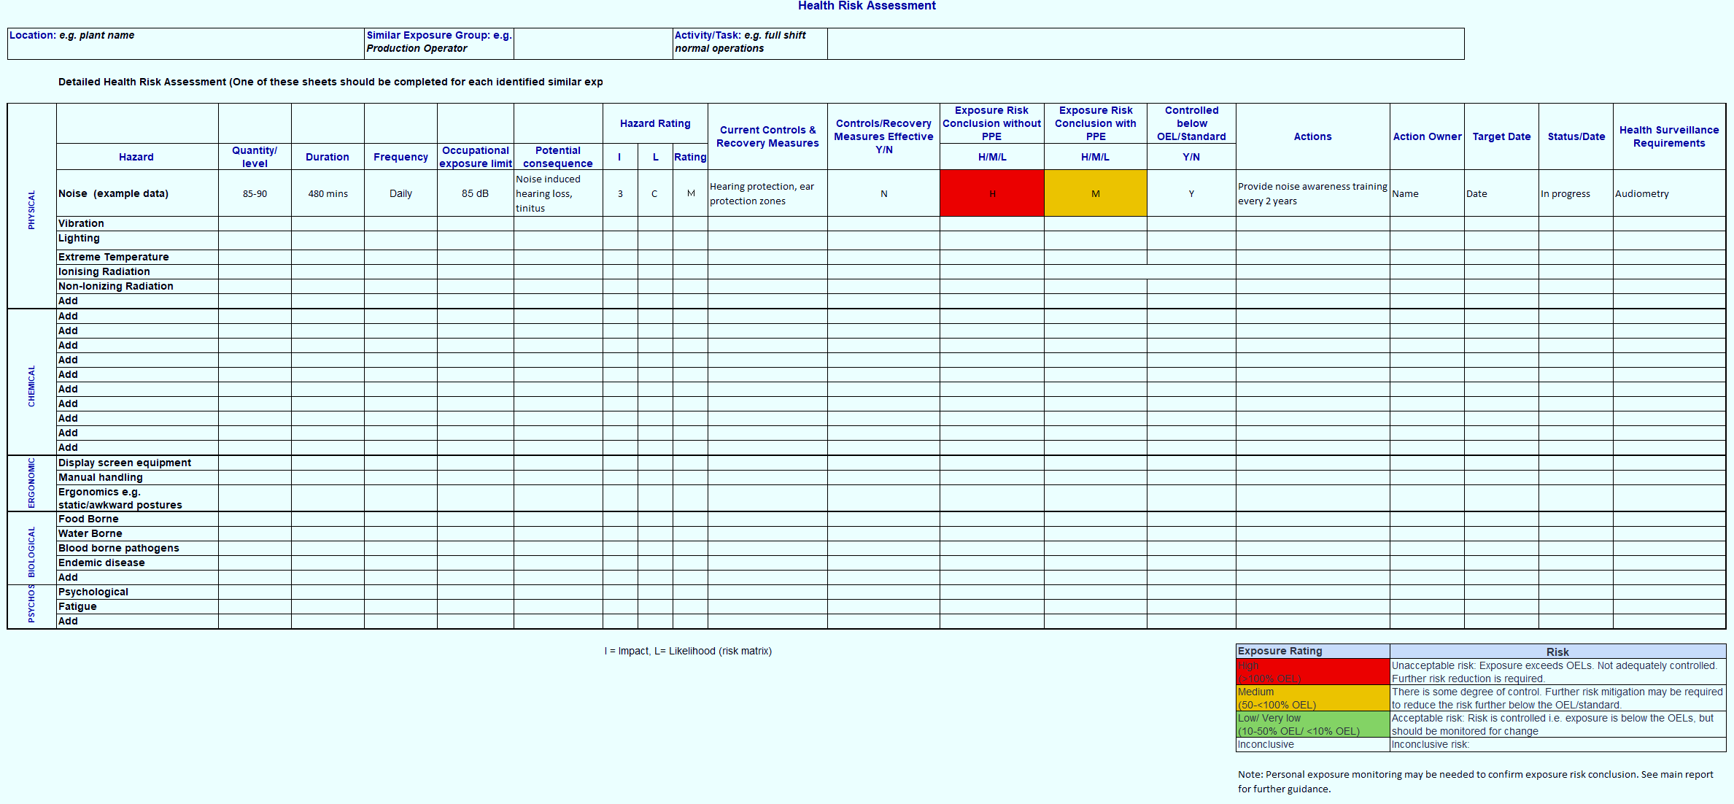
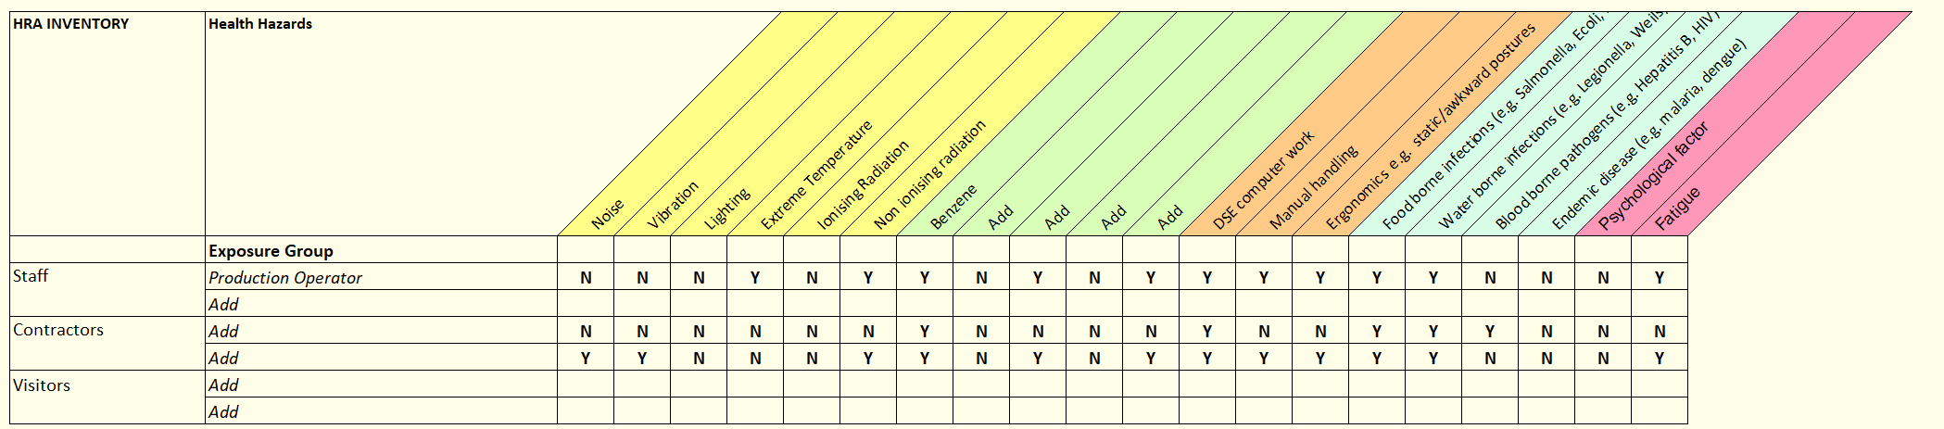
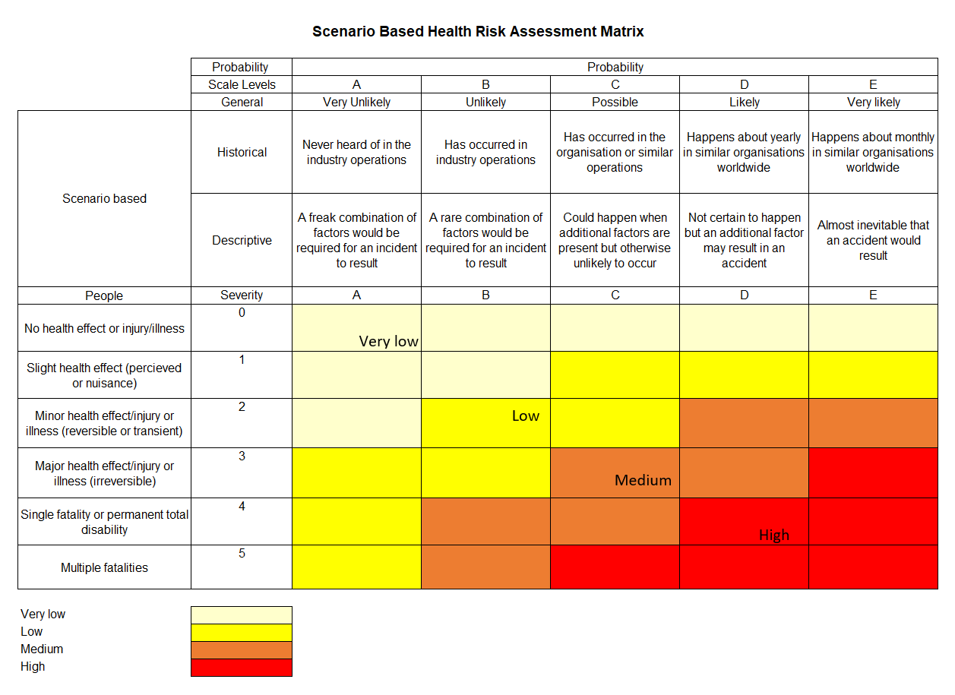
Simple HRA Tool
Notes:
Simple HRA tool comprises an excel spreadsheet
Tab 1: HRA Title, location, assessors, approver
Tab 2: HRA/hazard inventory
Tab 3: Risk matrix
Tab 4: HRA template (which can be copied for each worker group/ activity as needed.

Slide 10
BACK UP –
Training Material:
How to conduct the HRA in more detail.

Slide 11
How to Conduct HRA
HRA plan and schedule
Select HRA team
Information Gathering – Facility diagrams, exposure assessment data, etc.
Hazard identification and hazard assessment
Risk Assessment Process
  Qualitative Risk Assessment
  Quantitative Risk Assessment
Risk Communication – Data analysis
Control Implementation

Slide 12


How to Conduct HRA
HRA plan and schedule
  Annual Plan
  Regulatory items
  Health Condition reports
  Near misses
  Exposure Assessment data
Notes:
Annual HRA management plans should be developed, including HRA and monitoring priorities
2. Annual plans should be developed considering previous plans, HRAs and monitoring results, remaining recommendations (ongoing or not yet completed), anticipated business objectives/projects, and potential regulatory impacts that may be forthcoming in the next year.

Slide 13

How to Conduct HRA
2. Select HRA team
  Operations and Maintenance team
  Occupational hygienists
  Occupational health physicians
  Engineers
  Other Specialists (e.g. toxicologists, epidemiologist, ergonomists etc.
Notes:
The HRA team could include operations and maintenance personnel, HSE professionals, occupational hygienists, clinical health staff, and other specialists (e.g., toxicologists,
epidemiologists, ergonomists, human factor engineers, occupational health physicians, and infectious disease specialists). The required competence of the HRA assessors is dictated by the activities being assessed, the nature and severity of the hazards and risks involved, as well as the familiarity of the activities

Slide 14
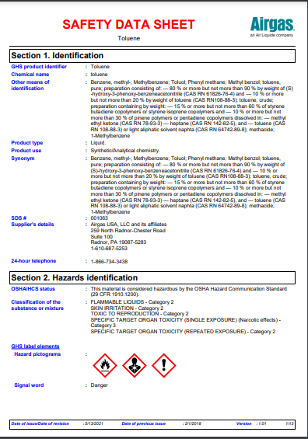
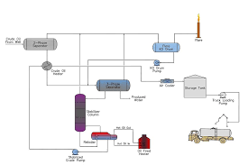
How to Conduct HRA
3. Information Gathering
  Occupational Hygiene Monitoring Reports
  Workflow charts
  Occupational Illness and Incident Reports
  Safety Data Sheets
  Project design information
  (including digital design models
  if available)
  Trade Association Materials
Notes:
The health hazard identification process usually requires the involvement of a person who has had training in health hazard identification, together with individuals familiar with
the activity being assessed
Useful sources of information for HRAs include existing site occupational hygiene monitoring reports, workflow charts, occupational illness and incident reports, trade
association material, such as IOGP-IPIECA Reports

Slide 15
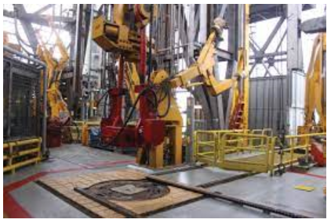

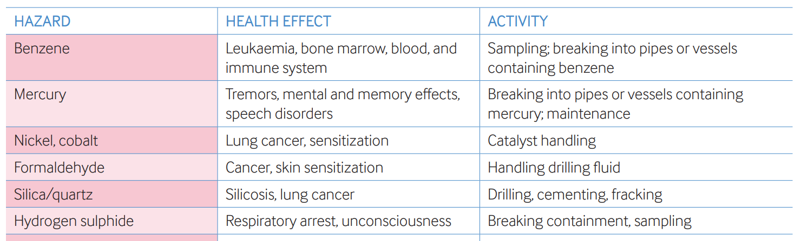
How to Conduct HRA
4. Hazard identification and hazard assessment
  Hazard Inventory – biological, physical, chemical
  Harmful effects of hazards - acute and/or chronic
  High risk tasks
  Frequency of tasks
  Hazardous work areas
  Effectiveness of existing control measures
Notes:
An inventory of health hazards in the assessable unit should be identified and listed. For each health hazard, the following should be identified:
• Harmful effects and whether these are acute and/or chronic
• Quantity or size of the hazard, e.g., whether it is acting on the whole or specific parts of the body
• Routes of entry, e.g., through skin or eye contact, inhalation, ingestion, or hearing
• Any hazard rating (e.g., health hazard rating scheme, Globally Harmonized System of Classification and Labelling of Chemicals (GHS) hazard code)
Relevant OELs or standards representing adequate controls

Slide 16
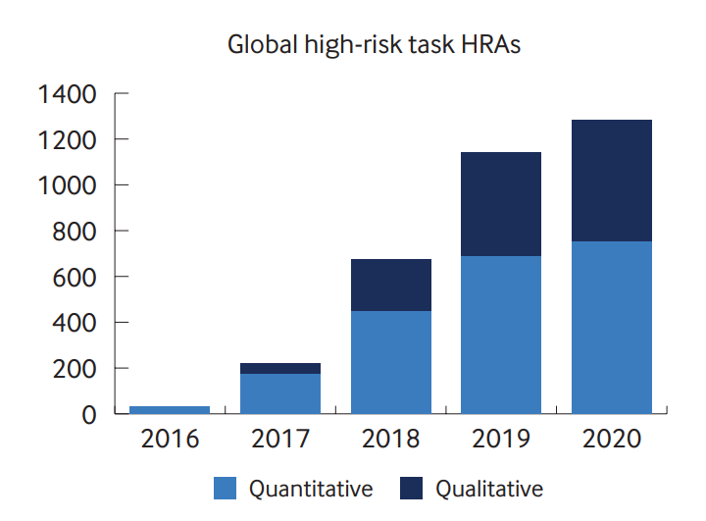
How to Conduct HRA
5. Risk Assessment Process
  Competent facilitator
  Multifunctional group
  Qualitative Assessment
  Quantitative – Exposure monitoring data
  Tools for documentation
Notes:
The overall aim of a qualitative HRA is to estimate the risks to health and determine the most appropriate control measures to reduce risks.
The HRA team could include operations and maintenance personnel, HSE professionals, occupational hygienists,
clinical health staff, and other specialists (e.g., toxicologists, epidemiologists, ergonomists, human factor engineers,
occupational health physicians, and infectious disease specialists)
HRAs for complex activities and/or new projects should be facilitated/lead by competent assessor who has undergone
the requisite training to lead such HRAs
A detailed qualitative assessment to collect HRA information is required, it is important to observe, verify, and talk to those involved about operating conditions.
Workplace exposure monitoring is part of an HRA. It can further support the HRA exposure risk conclusion
Company metric can be a great tool to document and drive an increase in exposure monitoring for short-term, higher-risk tasks to better confirm exposure risk conclusions (HRA, health risk assessment)

Slide 17
How to Conduct HRA
6. Risk Communication and Documentation
  HRA Reports/Management Presentation
  Risk matrix
  Stewardship tools
  Record keeping
Notes:
HRA reports should be developed with details of unacceptable exposure, action should be taken to inform any affected personnel and ensure they are protected. A remedial action plan should be documented, listing the additional control and recovery measures needed both in the short and longer term
In a bow-tie model are used for visual risk communication tool, in which the exposure incident is placed in the centre, the hierarchy of controls are the preventive barriers to the left, whose aim is to prevent the exposure incidence from occurring
HRAs, associated exposure monitoring data, and actions should be documented and kept in accordance with local
regulatory requirements and local company record retention policies

Slide 18
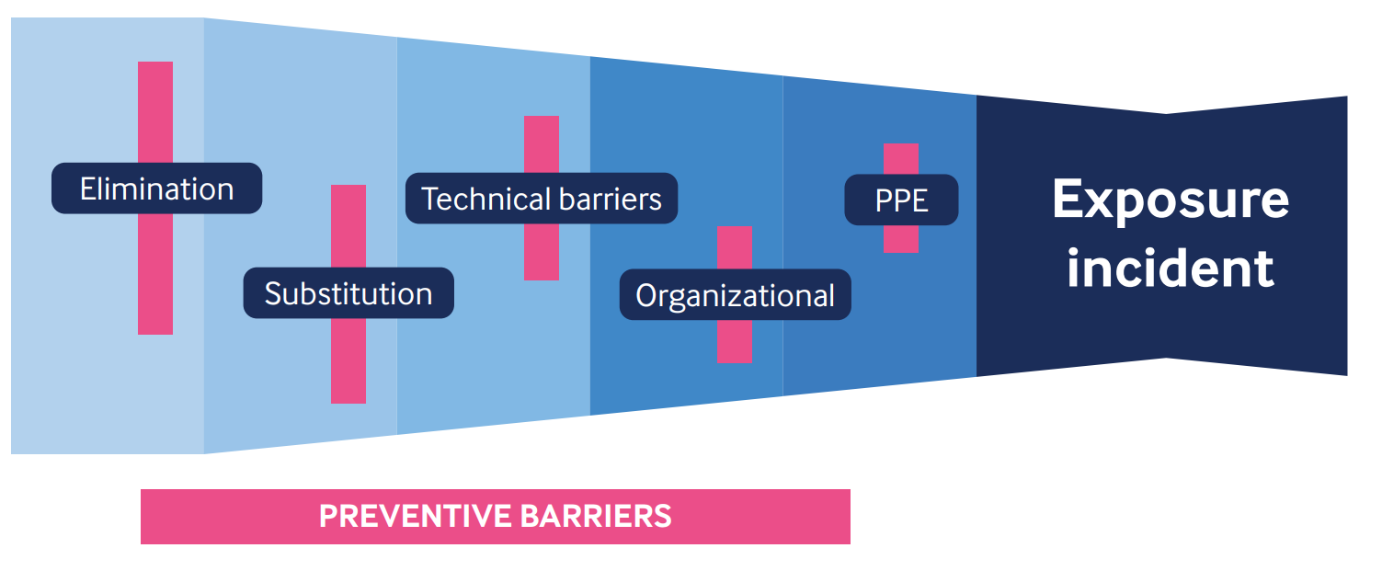
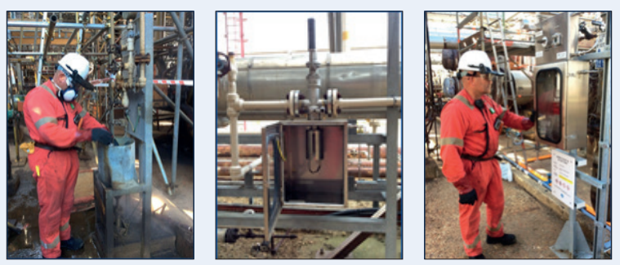
How to Conduct HRA
7. Control Implementation
  Hierarchy of control
  Engagement of all stakeholders
  Endorsement of control option
  Validation of controls
Notes:
For risks assessed as high, serious consideration should be given to eliminating, substituting, or finding alternative ways
of carrying out the operation to avoid the risk.
Effective communication and partnering with business managers, field operations personnel, engineers, procurement team are critical to successful implementation of a risk control project. Know your partners and establish good networks.
As control measures and solutions are implemented, they should be validated and it is critical to communicate what success looks like. This can be accomplished via ‘before and after’ examples and a visual
timeline

Slide 19
WORKSHOP
WORKSHOP

Slide 20
HRA Example 1
Scenario: A worker is exposed to noise above 95 dB(A) during maintenance of compressors which could potentially result in hearing loss.
Existing Barriers:
Potential Consequence of unmitigated risk:
Frequency of Exposure:
Unmitigated Risk:
Identified mitigations:
Post implementation risk:
Utilize HRA worksheet to document HRA result

Slide 21
HRA Example 2
Scenario: A worker is exposed to benzene during product sampling (open system) which could result in long term health effects such as leukemia
Existing Barriers:
Potential Consequence of unmitigated risk:
Frequency of Exposure:
Unmitigated Risk:
Identified mitigations:
Post implementation risk:
Utilize HRA worksheet to document HRA result

