Slide 1

Health Risk & Management -
Awareness
IOGP/IPIECA IH Subcommittee
May 22

Slide 2

Health Risk Assessment & Management: A roadmap for the Oil & Gas industry, IOGP Report 384, 2021 (Rev 2)
Executive Summary
A commitment to health risk management is a fundamental principle held by oil & gas business management. The Health Risk Assessment (HRA) & Management process ensures the identification of health hazards, assessment & control of potential risks to health, avoiding occupational illness in employees & contractors.
Revision 2, is a significant update since Revision 1, published over 10 years ago
Change: Increased emphasis on health risk management within business, new risk assessment techniques, up to date references & examples, a compendium of case studies, good practices & a simple excel based HRA tool
Notes:
Revision 1 Published 2006, Leaflet & Part 2 document (68+ pages)
Shortened industry focused guide with compendium

Slide 3
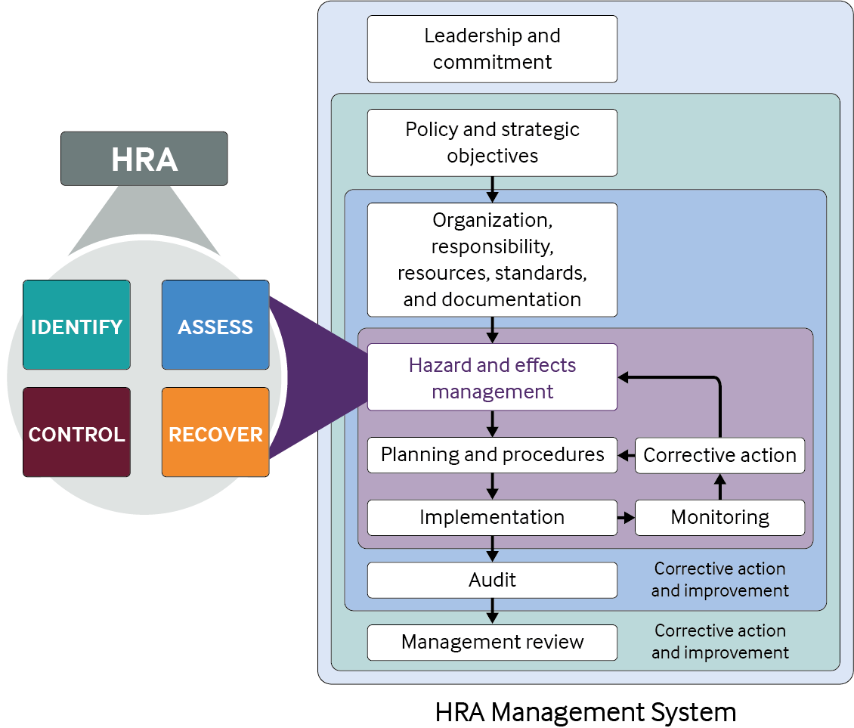
Health risk assessment and management within the business model (1)
(1) Alignment with business objectives
HSE programmes enable businesses to effectively & efficiently meet operational effectiveness goals & include
Licence to operate
Business continuity
Emergency preparedness and response
Human performance
Regulatory compliance and responsible standards
(2) HSE Management system & integration of health
(3) Management communication and engagement
Management support is essential
Annual health risk management plans
Notes:
Alignment with business Objectives
Licence to operate – stakeholder expectations for successful operations incl. maintaining a safe and healthy workplace
Business Continuity plans e.g. pandemic planning
Emergency preparedness & response e.g. team drills & vapour release consequences
Human performance – ensure effective workforce incl health surveillance FTW, well being initiative
Regulatory compliance and responsible standards – workplace HSE regulations, industry guides
(2) HSE Management system Health risks managed systematically as part of HSE Management System; Business management owns HSE-MS & accountable for implementation . Describe process flow
(3) Management communication & engagement is essential: HRA annual management plans should be in alignment with the business financial planning & budget cycle & should involve front-end input from health risk assessors, HSE counterparts

Slide 4
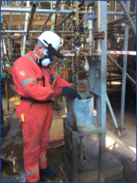
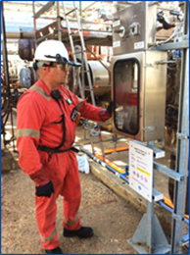
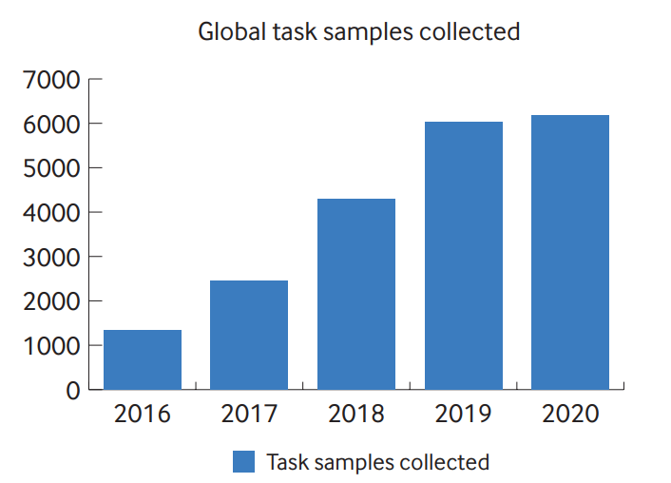
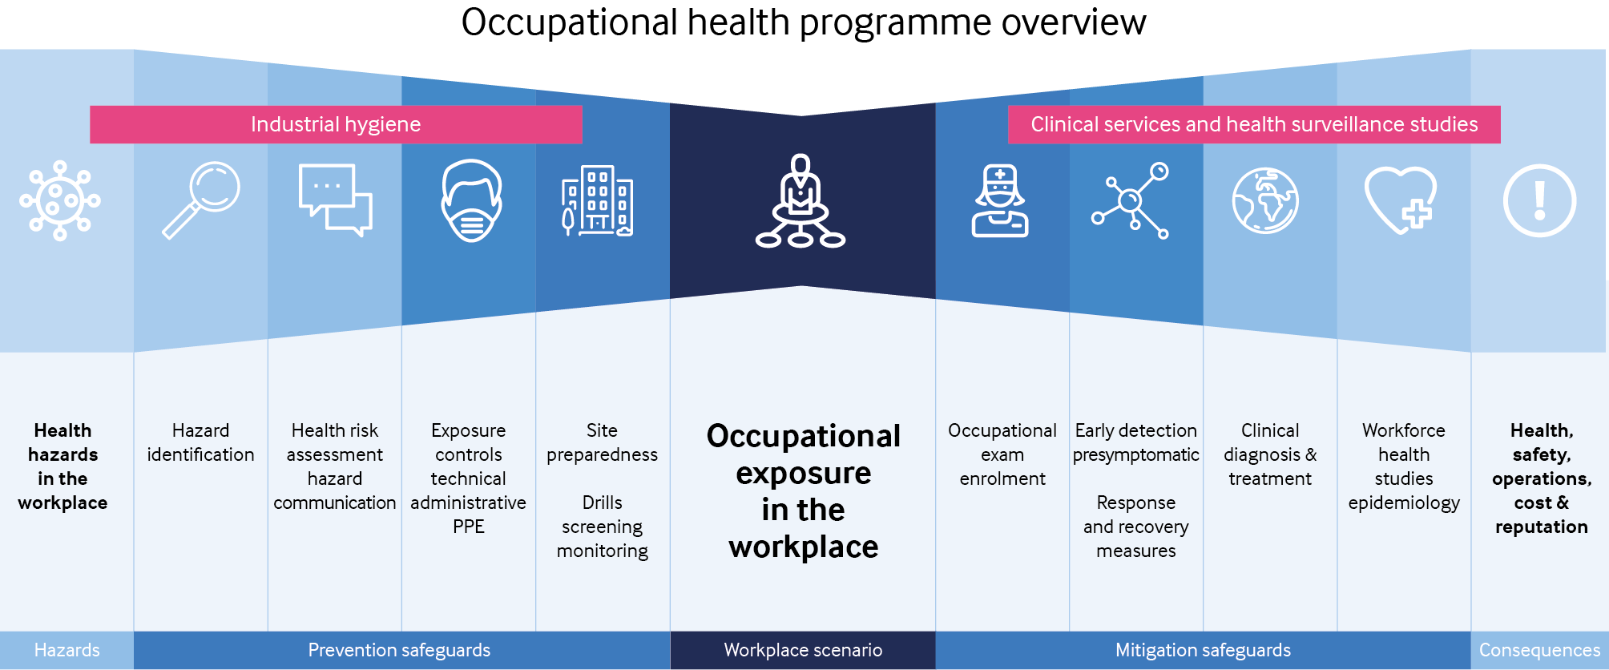
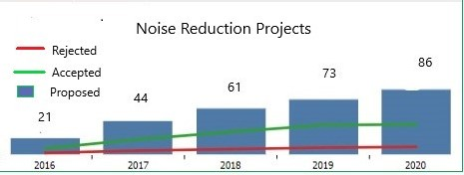
Health risk assessment and management within the business model (2)
(4) Metrics and performance indicators
Data quality metrics
Health risk assessment process/activity metrics
Programme effectiveness/outcome metrics
(5) Communication Tools
Keep communications brief,
straightforward & visual
where possible
Communication & business
partnering of risk & control
Communicate successes
Before and after visual example using photographs for a benzene exposure control improvement using closed loop system
Notes:
Metrics and performance indicators for health risk management are a key element to evaluate programme effectiveness and value to the business
Data quality metrics – ensures data is sufficient quality for decision making e.g. % HRAs not approved by occ hygienist
Health risk assessment process/activity metrics – measure points in process e.g. % HRAs complete per plan; chart with blue bars is driving an increase in sampling for short term tasks
Programme effectiveness/outcome metrics – Engineering solution implementation, action close out, Chart with blue bars - green line shows the number of engineering technical measures accepted and implemented and the red line shows the projects not accepted and that remain reliant on the weaker safeguard of PPE. This type of metric can help drive implementation of engineering/technical solutions versus administrative or PPE controls
Management communication and engagement should be short e.g. bow ties (blue diagram)
Ensure management understand risk and why risk reduction is important

Slide 5
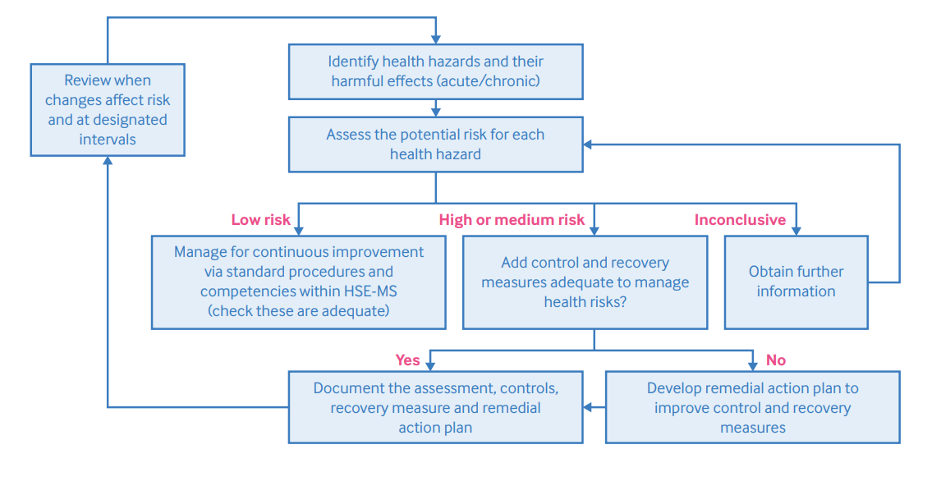
Health risk assessment (1)
AIM: To identify workplace health hazards, evaluate their risks to health & determine appropriate control & recovery measures.
Notes:
It is a systematic approach used to evaluate the potential for harm and protect against any adverse exposure. This figure shows the elements of HRA and the process

Slide 6
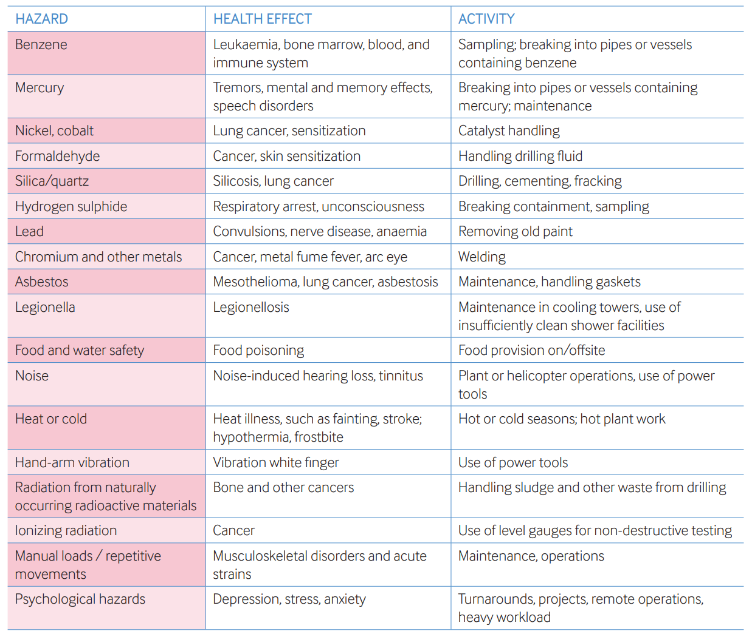
Health risk assessment (2)
Organization, scope & resources
Hazard identification including inventory & hazard assessment
Health risk assessment process
  Risk rating schemes
  Qualitative risk assessment methodology & tools
  Quantitative exposure assessment: types, future technologies
  Simple spreadsheet tool provided (slide 8)
Example higher-risk hazards, health effects, and activities in the oil & gas industry
Notes:
Scope – e.g. New activities and developments, Existing operations, Changes to existing activities etc
Resources & organisation – depends on depth complexity & scope of HRA e.g. single assessor vs team with specific knowledge & expertise
Hazard inventory chemical, biological physical, ergonomic & psychological factors
Risk Assessment:
Consideration of factors e.g. quantity, frequency, process details, controls in place etc. Observation (if possible) is important. Use of video technology can aid if not.
Quantitative assessment involves collecting data to further quantify exposure using personal, direct reading methods & modelling methods. Advances being made in sensor technology & big data

Slide 7
Health risk assessment (3)
Health Risk Management
  Control & recovery Measures
  Maintenance of control & recovery measures
  Communicating controls & recovery measures
  Health Surveillance & occupational epidemiology
  Documenting & reviewing HRAs
  Competence & training of Assessors
Notes:
Control: incl. hierarchy of control i.e. elimination, substitution, technical organisation & PPE (RHS of bow tie)
Recovery: incl. medical emergency response, clinical treatment, health surveillance (LHS of bow tie)
Maintenance ensures control/recovery measures reman effective e.g. LEV testing, maintaining procedures, cleaning & repairing PPE
Communicating includes action management, information & training (permit to work, toolbox talks etc)
Health surveillance/occ. Epidemiology – e.g. to identify early signs, symptoms/ examine health outcomes of groups of workers exposed to hazards
Document/review HRAs: records kept, review if change
Competence: Assessors (training, W201). Occupational Hygienists (IOHA NAR scheme)

Slide 8
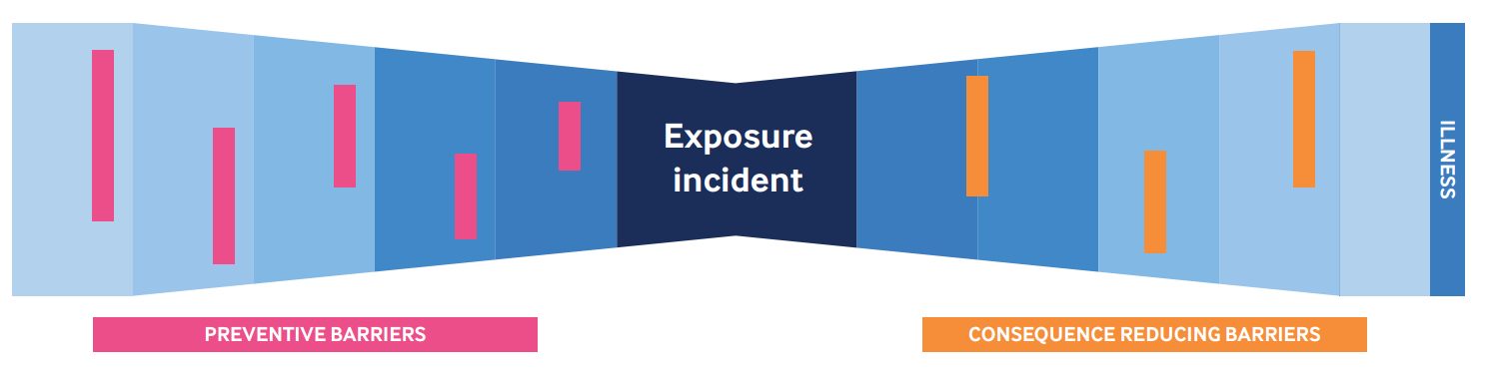
Health risk management (3)
Health Surveillance & occupational epidemiology
Documenting & reviewing HRAs
Competence & training of Assessors
Control & recovery Measures
Maintenance of control & recovery measures
Communicating controls & recovery measures
Notes:
Control: incl. hierarchy of control i.e. elimination, substitution, technical organisation & PPE (RHS of bow tie)
Recovery: incl. medical emergency response, clinical treatment, health surveillance (LHS of bow tie)
Maintenance ensures control/recovery measures reman effective e.g. LEV testing, maintaining procedures, cleaning & repairing PPE
Communicating includes action management, information & training (permit to work, toolbox talks etc)
Health surveillance/occ. Epidemiology – e.g. to identify early signs, symptoms/ examine health outcomes of groups of workers exposed to hazards
Document/review HRAs: records kept, review if change
Competence: Assessors (training, W201). Occupational Hygienists (IOHA NAR scheme)

Slide 9
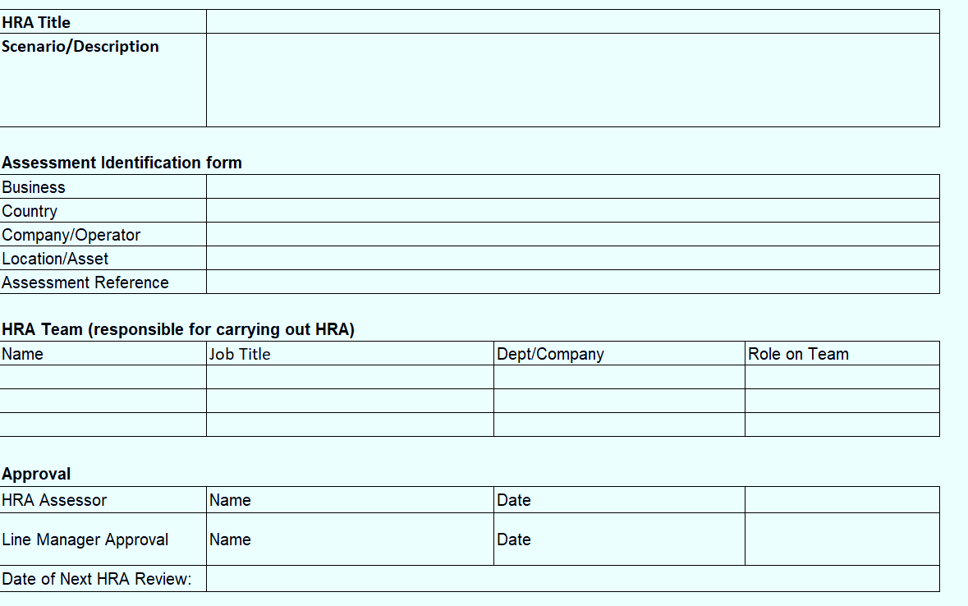
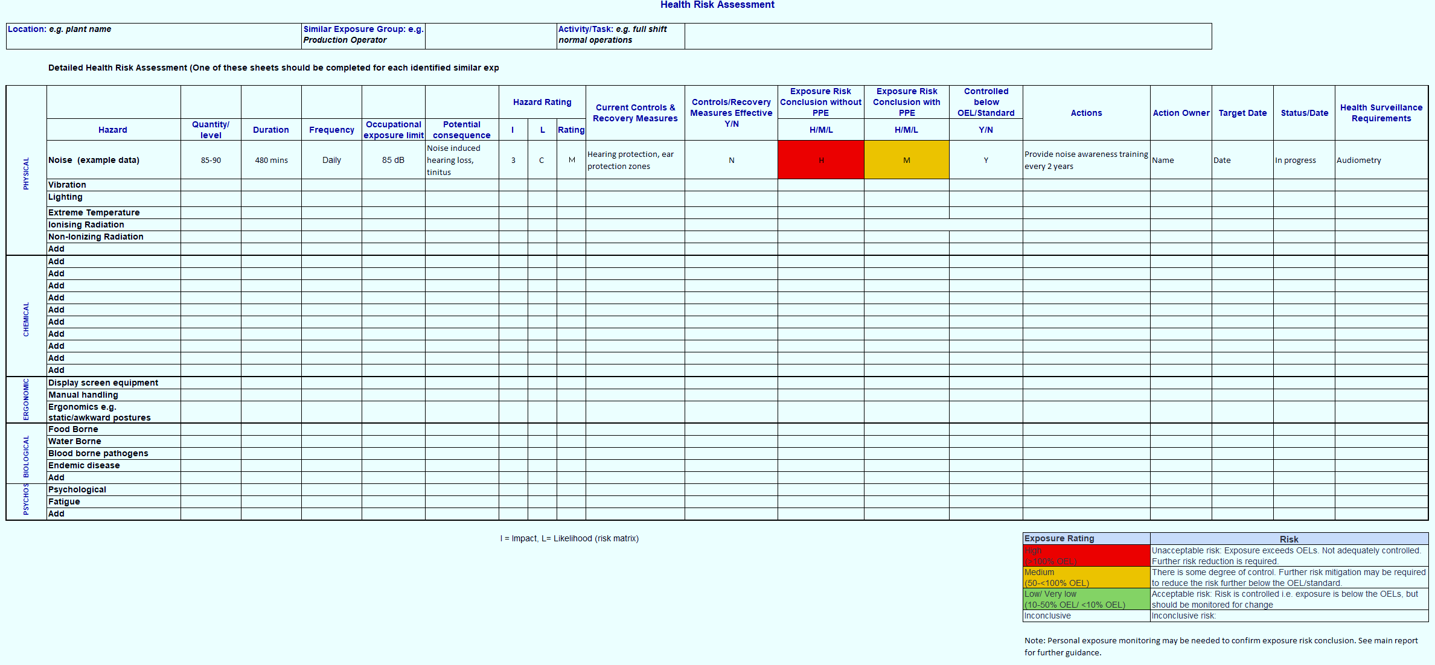
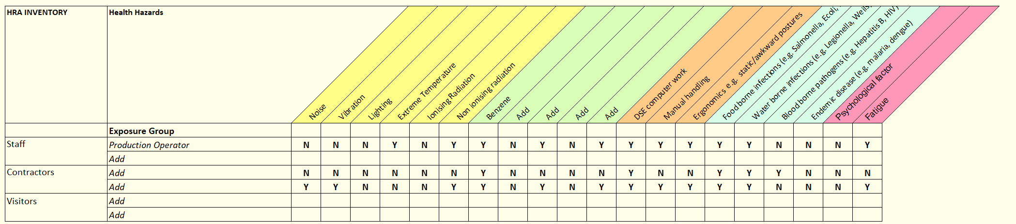
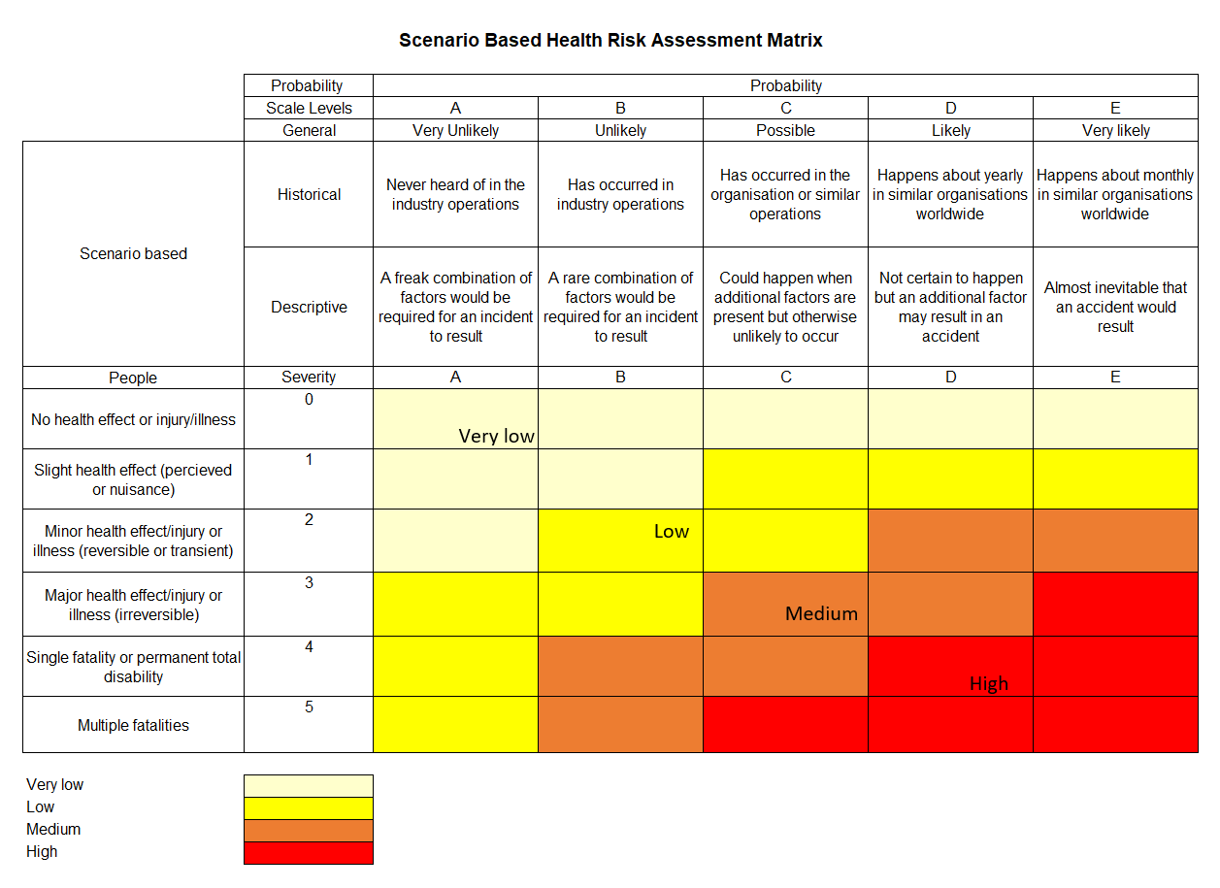
Simple HRA Tool
Notes:
Simple HRA tool comprises an excel spreadsheet
Tab 1: HRA Title, location, assessors, approver
Tab 2: HRA/hazard inventory
Tab 3: Risk matrix
Tab 4: HRA template (which can be copied for each worker group/ activity as needed.

