Slide 1
INSTRUCTIONS
This slide pack introduces the IOGP Process Safety Fundamentals (IOGP PSF)
If you are implementing the Fundamentals, please consult IOGP Report 638 for further guidance
IOGP asks users to not modify the wording or icons of the PSF
Organisations can adapt the contents of these slides, for example to describe:
  For each PSF, the specific site/company processes and procedures that the PSF is (most) relevant to
  Expectations of each person
  Proper responses to situations where a PSF cannot be followed
We have included links to external videos that can illustrate why a PSF is important, or explain particular concepts
  IOGP recommends you use examples from your own site or company history
  You are very welcome to add - or replace - these external resources using your own company materials, or other materials that are more relevant for the particular audience.
  The more you tailor this pack to your audience, the better!

Slide 2
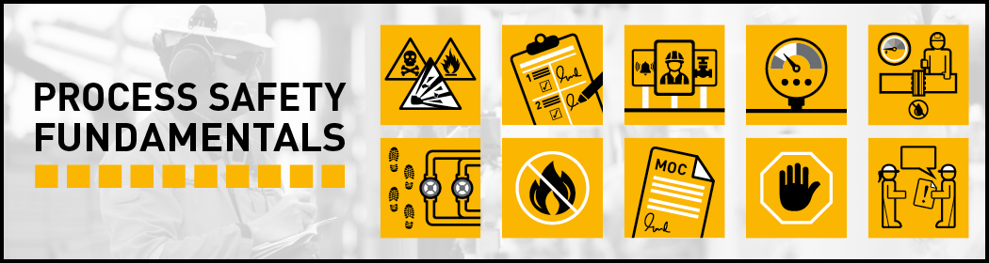
Process Safety Fundamentals
AN INTRODUCTION
Notes:
I would put this slide first

Slide 3
What are the Process Safety Fundamentals?
  Key actions to reduce, and ultimately eliminate, fatal and high severity Process Safety Events (PSE)
  Support frontline workers
  Clear
  Simple
  Task-level
  Observable
  Clearer picture of what Process Safety means in day-to-day activities
  Proactive
  Actionable
Notes:
Talking points – extra info
- Data analysis period: 2007-2017)

Slide 4
What are the differences? PSF vs Life-Saving Rules
Aspect | LSR | PSF
Focus | Primary focus on personal safety with some Process Safety overlap | Solely focused on Process Safety
Flexibility | Single common industry set recommended by IOGP | Core set recommended by IOGP, with flexibility to supplement or exchange a small number based on local Process Safety challenges

Slide 5
How were the PSF developed?
We wanted to provide workers in the industry with actions they can take to protect themselves and their colleagues, no matter the worksite
Data over ten years (2007-2017) indicates that 128 people lost their lives in 56 Process Safety Events
The fundamentals were developed to be data-driven to reduce, if not eliminate, fatal and high severity PSEs
Designed PSFs based on 2007-2017 dataset, including Fatal and High Severity PSEs
We created 10 Fundamentals with simple icons and clear actions for individuals
Tested with IOGP Member Companies workforce representatives and Human Performance experts

Slide 6
128 people might still be alive if PSF had been implemented

Slide 7
Not another set of rules…
There will be situations when trying to align with a PSF may prove difficult – this is expected. Please tell us about it.
You have the knowledge of actually performing the task at the site. If a PSF is difficult or impossible to apply on any one occasion, we want to know so that we can make it possible or easier.
Only by bringing these issues into the open can we learn of them and decide what to do.
Sometimes it can be a simple fix, sometimes it might be harder, but we are committed to acting every time you us bring us a PSF dilemma.

Slide 8
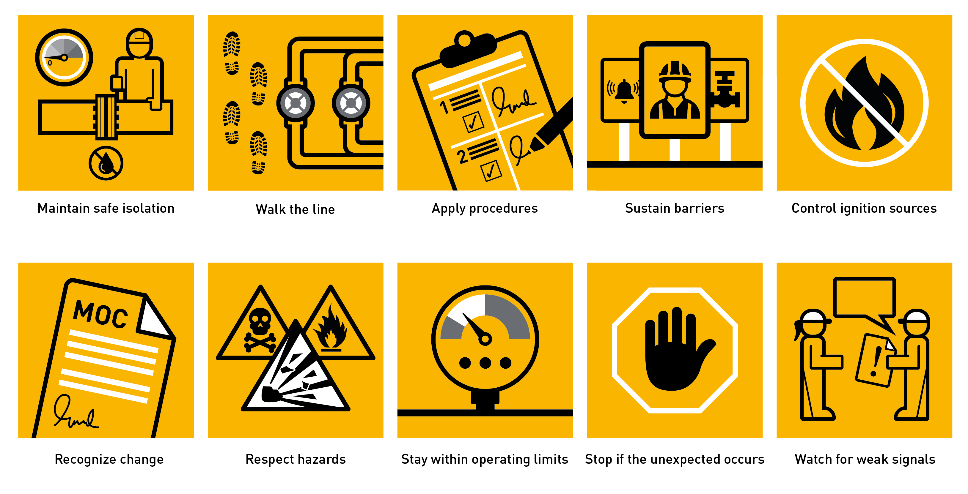
The PSF

Slide 9

WE RESPECT HAZARDS
We improve our understanding of process safety hazards at our location and our roles in controlling them.
We are vigilant about the potential impacts of uncontrolled process safety hazards.
We discuss process safety hazards before starting a task.
We bring forward process safety hazards to be included in activity risk assessments.

Slide 10
WE RESPECT HAZARDS - discussion
Additional guidance
  PS Hazards – It’s important to understand the process safety hazards at our facilities and be aware of the harm they could cause if we lose control of them – can you think of examples?
  Avoiding risk normalization - When we routinely work close to process safety hazards, it is easy to become desensitized to them – what are some hazards that we don’t always think about?
  Alert - Teams are encouraged to be alert for risk assessments that do not cover all the process safety risks associated with an activity – how can we make sure we think of these hazards during our day-to-day work?
Useful links
  Energy Institute Reflective Learning video – ‘Removing the hazards’
  Step change Major Accident Hazard Understanding videos and tool packs
  Safer Together videos and other tools

Slide 11

WE APPLY PROCEDURES
We use operating and maintenance procedures, even if we are familiar with the task.
We discuss the key steps within a critical procedure before starting it.
We pause before key steps and check readiness to progress.
We stop, inform supervision, and avoid workarounds if procedures are missing, unclear, unsafe, or cannot be followed.
We take time to become familiar with, and practice, emergency procedures.

Slide 12
WE APPLY PROCEDURES - discussion
How do we apply procedures?
  Verify that procedures are up-to-date, effective, and easy to use.
  Follow up if concerns about a procedure are raised.
  Become familiar with the plant, its equipment, and its procedures.
  Keep aware and informed of Emergency Response procedures?
Useful links
  US Chemical Safety Board: Fire in Baton Refuge
  US Chemical Safety Board: Bayer CropScience Pesticide Waste Tank Explosion
  Refer to local company guidance on procedures, consider linking to Human Factors guidance

Slide 13

WE SUSTAIN BARRIERS
We discuss the purpose of hardware and human barriers at our location.
We evaluate how our tasks could impact process safety barriers.
We speak up when barriers don’t feel adequate.
We perform our roles in maintaining barrier health and alert supervision to our concerns.
We use an approval process for operations with degraded barriers.

Slide 14
WE SUSTAIN BARRIERS - discussion
How do we sustain barriers?
  What are the PS barriers at our location?
  How does my work affect these barriers?
  Ensure that systematic barrier management processes are in place and that necessary resources are allocated to test and maintain barriers.
  Implement approved risk reduction measures for degraded or failed barriers and restore barrier functionality as soon as practical.
Useful links
  Energy Institute Reflective Learning - I own my barrier
  Energy Institute Reflective Learning - I keep my barrier strong

Slide 15

WE STAY WITHIN OPERATING LIMITS
We discuss and use the approved operating limits for our location.
We escalate where we cannot work within operating limits.
We alert supervision if an alarm response action is unclear or the time to respond is inadequate.
We obtain formal approval before changing operating limits.
We confirm that potential for overpressure from temporary pressure sources has been addressed.

Slide 16
WE STAY WITHIN OPERATING LIMITS - discussion
How do we stay within operating limits?
  Document SOL (Safe Operating Limit) for key process variables & make them visible to frontline workers
  Regularly check personnel knowledge & skills to stay within operating limits
  Systematically investigate excursions outside SOL
  Demonstrate through decisions that cost, production, or schedule does not override safety
Useful links
  US Chemical Safety Board: Anatomy of Disaster - BP refinery, Texas City
  US Chemical Safety Board: Airgas Safety Spotlight
  Centre for Chemical Process Safety: Know the temp capability of your plant - both high and low!

Slide 17

WE MAINTAIN SAFE ISOLATION
We use isolation plans for the specific task, based on up-to-date information.
We raise isolation concerns before the task starts and challenge when isolation plans cannot be executed.
We check for residual pressure or process material before breaking containment.
We monitor the integrity of isolations regularly and stop to reassess when change could affect an isolation integrity.
We confirm leak-tightness before, during, and after reinstating equipment.

Slide 18
WE MAINTAIN SAFE ISOLATION - discussion
How do we maintain safe isolation?
  Monitor isolation practice at your location & verify its effectiveness. Implement improvement where issues are identified.
  Respond and follow up if isolation concerns are raised.
  Regularly check that those performing isolations are effectively trained and supported
Useful links
  US Chemical Safety Board: Key Lessons for Preventing Incidents during Maintenance
  US Chemical Safety Board: Explosion & Fire at Williams Olefins Plant, Geismar, Louisiana
  UK Health & Safety Executive: The safe isolation of plant and equipment

Slide 19

WE WALK THE LINE
We use up to date documentation (e.g., Piping and Instrumentation Diagrams, or P&IDs) that accurately reflect installed systems and equipment.
We physically confirm the system is ready for the intended activity (e.g., valve positions, line up of relief devices, etc.).
We alert supervision to identified documentation and readiness issues before operation.

Slide 20
WE WALK THE LINE - discussion
How do we walk the line?
  Regularly confirm that process safety information is accurate and up-to-date
  Discuss walk the line issues with front-line workers and follow up on concerns raised
  Check that systems are in good condition and correctly set-up each time we start them up or make a significant change in their use.
Useful links
  AIChE: Walk the Line
  Centre for Chemical Process Safety: Walk the line
  IOGP Member Company Example: Walk the line

Slide 21

WE CONTROL IGNITION SOURCES
We identify, eliminate, or control the full range of potential ignition sources during task risk assessments and during job preparation and execution.
We minimise and challenge ignition sources even in “non-hazardous” areas.
We eliminate ignition sources during breaking containment and start-up and shutdown operations.

Slide 22
WE CONTROL IGNITION SOURCES - discussion
How do we control ignition sources?
  Regularly check that personnel understand the full range of potential ignition sources and the requirements for ignition source control.
  Control work risk assessments to evaluate the potential for flammable hazards even outside classified/zoned areas shown on the area classification drawing.
  Report defects in electrical equipment to control potential ignition sources.
Useful links
  Centre for Chemical Process Safety: Managing static - a key part of reducing ignition sources
  Centre for Chemical Process Safety: Control ignition sources in your plant

Slide 23

WE RECOGNISE CHANGE
We look for and speak up about change.
We discuss changes and involve others to identify the need for management of change (MOC).
We review the MOC process for guidance on what triggers an MOC.
We discuss and seek advice on change that occurs gradually over time.

Slide 24
WE RECOGNISE CHANGE - discussion
How do we recognise change?
  Verify that systematic identification and management of change processes are in place and working effectively.
  Ensure that workforce personnel and management are trained to recognise change.
  Teams can review their local MOC process for guidance on what triggers their MOC process and discuss examples at their location.
Useful links
  US Chemical Safety Board: Fire from ice
  US Chemical Safety Board: Block In
  Centre for Chemical Process Safety: A minor change can have a big impact!

Slide 25

WE STOP IF THE UNEXPECTED OCCURS
We discuss the work plan and what signals would tell us it is proceeding as expected.
We pause and ask questions when signals and conditions are not as expected.
We stop and alert supervision if the activity is not proceeding as expected.

Slide 26
WE STOP IF THE UNEXPECTED OCCURS - discussion
How do we encourage workers to stop work if the unexpected occurs?
  Positively recognise people who stop to re-evaluate a task if it is not going as planned.
  Communicate to frontline workers that they should pause and seek guidance if an activity is not proceeding as expected.
  Pausing or stopping a task may feel inconvenient at the time but keeping an activity on plan and under control will avoid incidents, keeping people safe, and supporting good business performance.
Useful links
  Centre for Chemical Process Safety: Know when to stop - and when to get help!
  Scientific Drilling: Stop Work Authority - Protecting our most valuable resources

Slide 27

WE WATCH FOR WEAK SIGNALS
We proactively look for indicators or signals that suggest future problems.
We speak up about potential issues even if we are not sure they are important.
We persistently explore the causes of changing indicators or unusual situations.

Slide 28
WE WATCH FOR ‘WEAK SIGNALS' - discussion
How do we watch for weak signals?
  Be alert to weak signals and respond proactively when these signals are raised.
  Do so, even if the signals seem weak/small/unimportant, so that they can be discussed and evaluated.
  `Weak signals` can be a vital opportunity to act early to avoid and accident, so it is important that they are persistently explored to understand the cause.
Useful links
  Energy Institute Reflective Learning video – ‘Chronic unease’
  IOGP Member Company Example: Weak Signals

Slide 29





How should I use Process Safety Fundamentals?
STOP
Toolbox talks & Safety meetings
Can we learn from incidents that involved a PSF not being followed?
Pre-job planning
How are the PSF applicable to the work we are doing today?
What do we need to do to follow the PSF?
What needs to be in place?
Is everything in place, and in good working condition?
Last minute risk assessment
Have I done all the PSF actions relevant before the job?
Is everything as we discussed in the pre-job planning?
Are there any Line of Fire hazards or ignition sources we didn’t identify?
Post-job reviews
Did we take all the actions associated with the PSF?
What went well? What didn’t go well?
Is there anything to note for the next time we have to this perform task or work in this area?
Observations & walkabouts
Do you see anyone performing work where a PSF is relevant?
Are they following it?
Yes? Great, recognise it!
No? Intervene!
If someone brings up a PSF dilemma, thank them and show them you will take it seriously.
Intervention
Intervene or stop the work if a PSF is not being followed

Slide 30
Work does not start until we are all aware of the PSF and can confirm we can follow them throughout
STOP
We are all authorised to intervene or stop work if we are in any doubt about the safety of an activity or we can't follow the PSF
Notes:
Everyone has the authority and is encouraged to stop work and intervene if they observe potential or actual non-compliance to the PSF (Process Safety Fundamentals), or any other unsafe activity. Proactive intervention may be the last opportunity to prevent injury or fatality.

Slide 31
We are all authorised to intervene or stop work
STOP
Intervention can be the last opportunity to prevent a process release or a fatality.
I know, but it is not always easy to tell someone to stop the job.
Exactly, especially if it’s your boss!
Yeah, but it’s better to have an uncomfortable conversation now, than someone getting hurt later.
Notes:
Everyone has the authority and is encouraged to stop work and intervene if they observe potential or actual non-compliance to the Process Safety Fundamentals, or any other unsafe activity. Proactive intervention may be the last opportunity to prevent injury or fatality.

Slide 32
A closing message
Data reported by IOGP Members over a period of ten years (2007-2017) shows that 128 people lost their lives in 56 process safety events.
In response to this, the IOGP Process Safety Fundamentals (PSFs) have been developed to support companies as they seek to reduce, and ultimately eliminate, fatal and high severity process safety events.
PSF (Process Safety Fundamentals) designed to support those working in front-line operations, maintenance, and on wells teams.
They are therefore not intended to exhaustively address all process safety risks and hazards in the oil and gas industry, but to be deployed in addition to company`s underlying Process Safety Management system.

Slide 33

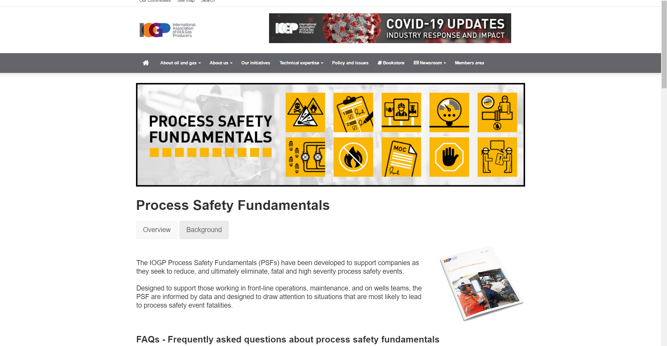






Visit our website for…
www.iogp.org/oil-and-gas-safety/process-safety/fundamentals/
Videos
Posters
Presentations
External resources
Get in touch!
infoPSF@iogp.org
+44 (0)20 3763 9700

